Slide 1


Your team name

Slide 2
About Our Team
Add your own photo or infographic here.
Delete background black box and send the new photo to the back.
Mission statement
The programs you offer
How your team is run (club, board, institutional)
*Can break these up on multiple slides as needed

Slide 3
Meet Our Coaches
Put Coach Image Here
Put Coach Image Here
Put Coach Image Here
Put Coach Image Here
Coach Name
Title
Contact Info
Coach Name
Title
Contact Info
Coach Name
Title
Contact Info
Coach Name
Title
Contact Info

Slide 4
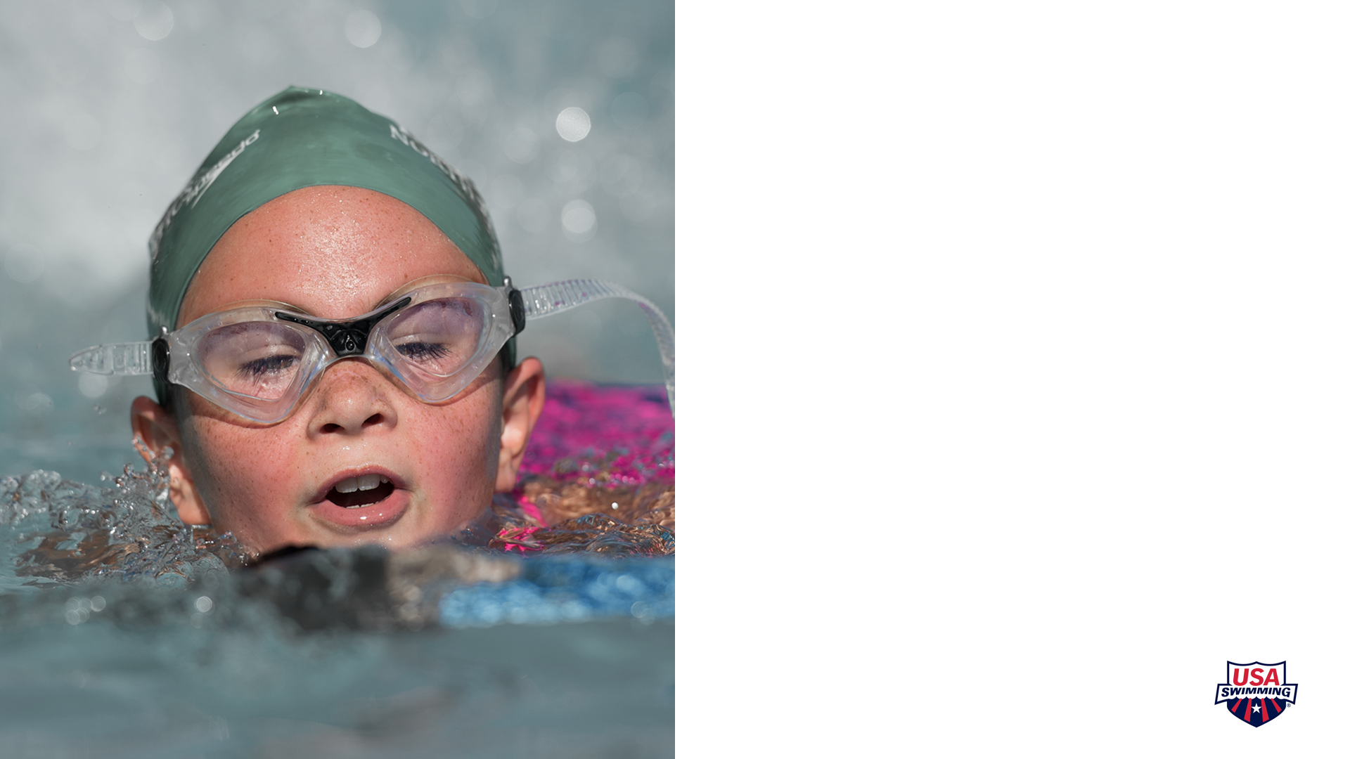
Safety Benefits
Not only is swimming fun, but it is also a lifesaving skill!
Drowning is the 2nd leading cause of unintentional injury or death for children under 14
Formal swimming lessons reduce the likelihood of childhood drowning by 88%

Slide 5

Health Benefits
Swimming is one of the best workouts for your physical and mental health
It’s a full body workout that will use muscles in your arms, legs, back and core
Great for your cardiovascular health (heart, blood vessels, lungs)
Gain mental toughness while staying focused and completing workouts

Slide 6

Academic Success
USA Swimming celebrates good grades with the Scholastic All-America Team. To be a part of this honor swimmers must:
Have completed 9th, 10th, 11th, or 12th Grade
Maintain 3.5 GPA while on the team

Slide 7
Social Benefits
Joining a swimming club can provide your child with lifelong social skills
Connecting with kids their age and their community
Leadership skills can be developed as confidence grows
Gaining time management skills
Learning to be adaptable to change and things out of their control

Slide 8
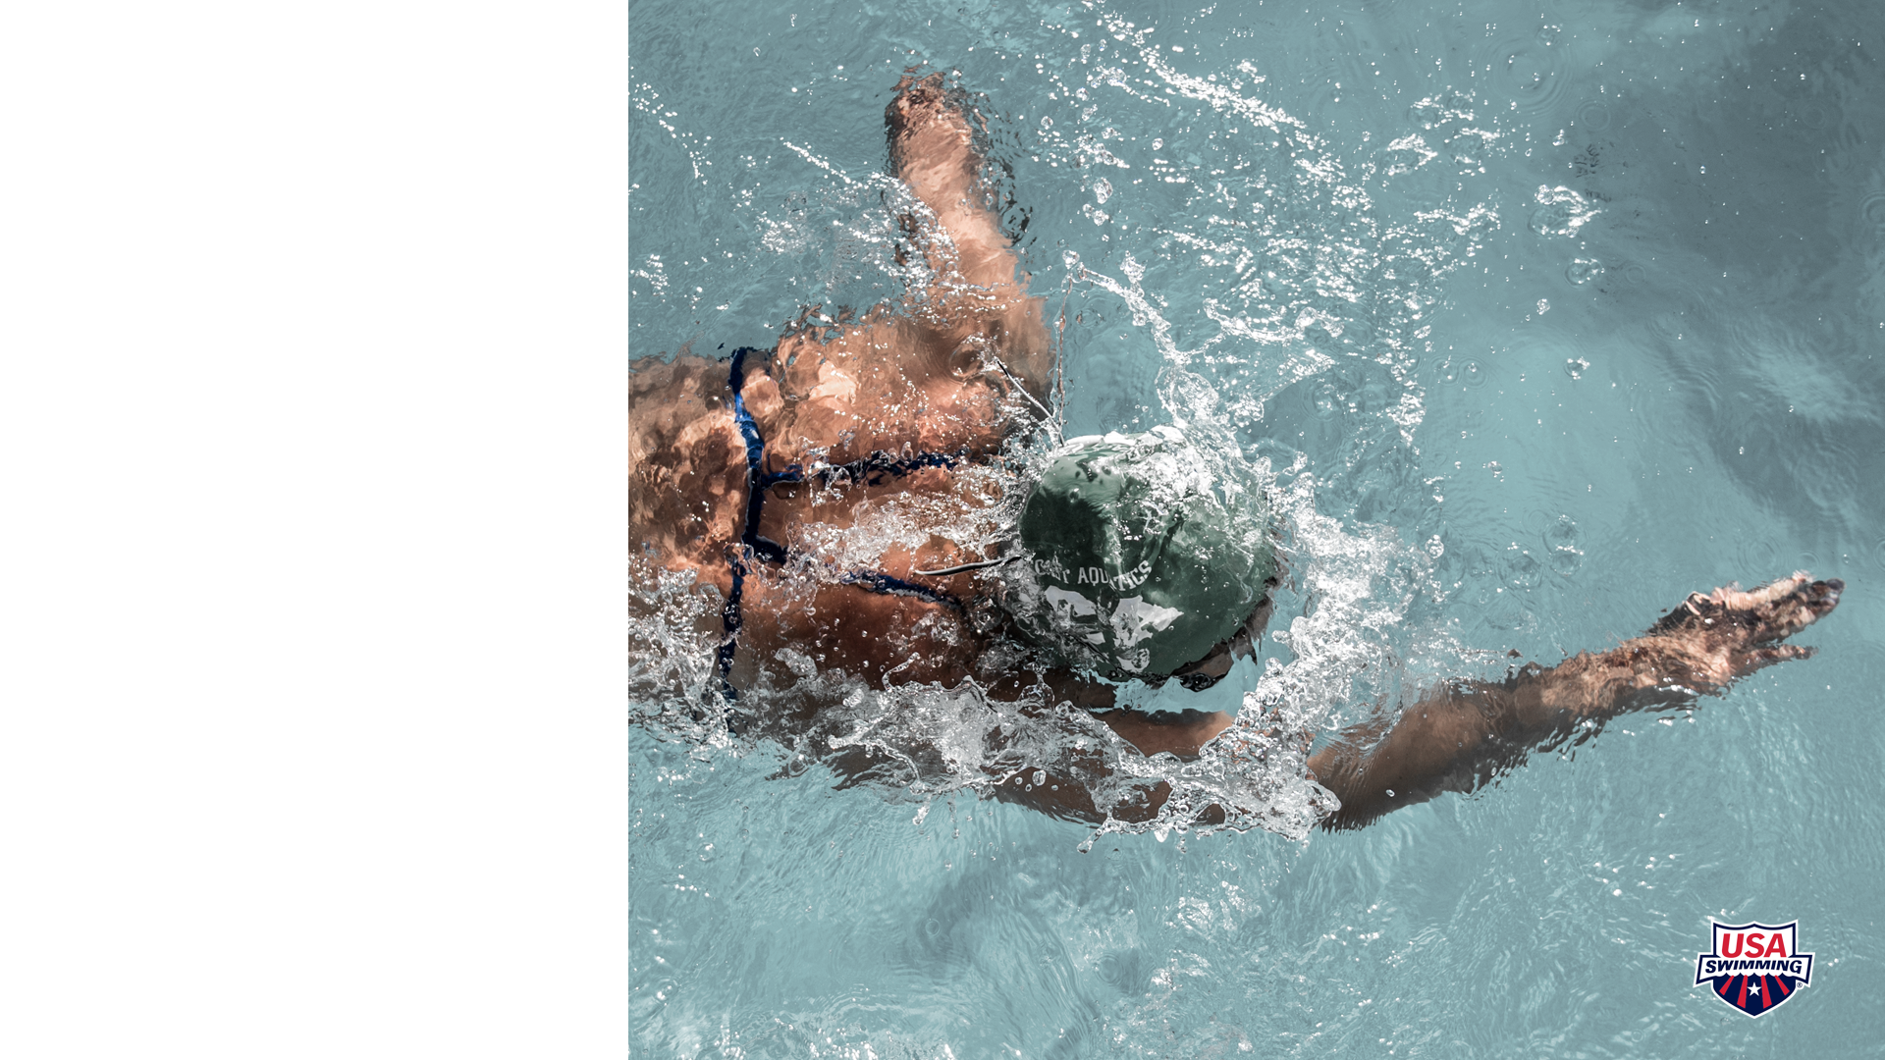
Community
Joining USA Swimming allows your child to connect with the community
Volunteering
Donations

Slide 9
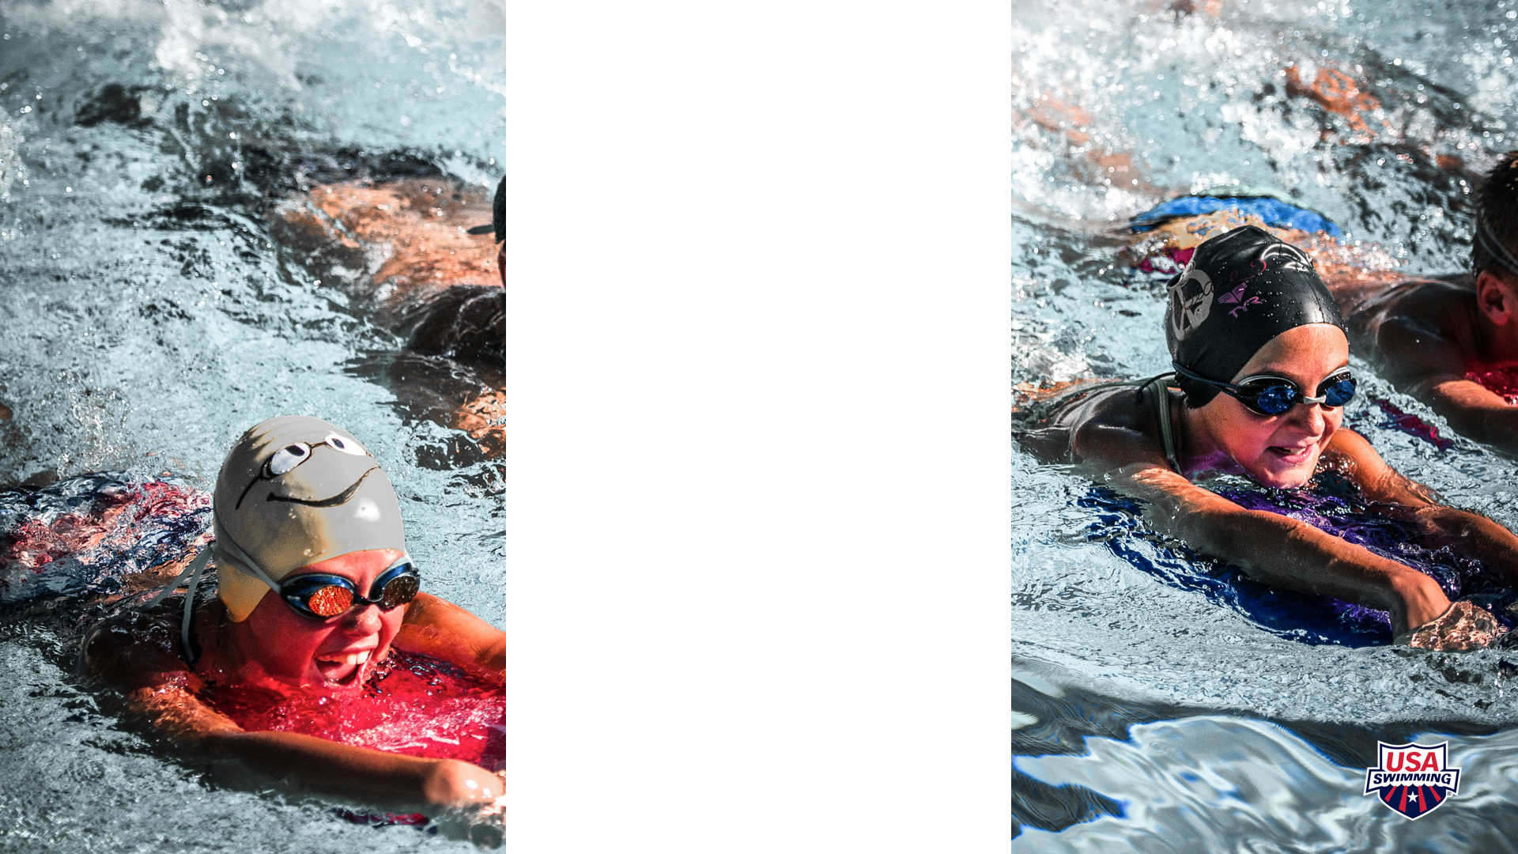
Upcoming Events
List your team’s upcoming events
  Also a chance to talk about past events

Slide 10

Safe Sport
USA Swimming’s Safe Sport program is USA Swimming's comprehensive abuse prevention program. It consists of a multi-layered approach to keep kids safe and includes required policies and best practice guidelines; mandatory screening, including criminal background checks and employment screening; training and education; monitoring, supervision and mandatory reporting.
List measures taken by your team, including MAAPP
Include if you are SSRP approved or any other additional measures your club takes

Slide 11
Interested in Joining?
Add your own QR Code here.
Delete background black box and send the new photo to the back.
Use “How to make a QR Code” resource to make a code for your join page
List other relevant information about joining

Slide 12

Questions?
[Insert Contact Information]

Slide 13

Thank You!

